Slide 1

Welcome to Sabbath School
Illustration by Jo Card. Copyright © 2024 General Conference Corporation® of Seventh-day Adventists.

Slide 2

EARLY ARRIVALS
EARLY
ARRIVALS

Slide 3

Books of the Bible
EARLY ARRIVALS
EARLY
ARRIVALS

Slide 4
Welcome to Sabbath School
Illustration by Jo Card. Copyright © 2024 General Conference Corporation® of Seventh-day Adventists.

Slide 5

Child of the King
OPENING ACTIVITIES
How can it be,
That God chooses me
And calls me His own?
I’m a child of the King.
How can it be,
That God chooses me
And calls me His own?
I’m a child of the King.
(Continued on next slide)

Slide 6
Child of the King
OPENING ACTIVITIES
I was made for more
Than to strive for worldly things,
For heaven is my home.
I’m a child of the King.
I was made for more
Than to strive for worldly things,
For heaven is my home.
I’m a child, a child of the King.
(Continued on next slide)

Slide 7
Child of the King
OPENING ACTIVITIES
How can it be,
That God chooses me
And calls me His own?
I’m a child of the King.
How can it be,
That God chooses me
And calls me His own?
I’m a child of the King.
(Continued on next slide)

Slide 8
Child of the King
OPENING ACTIVITIES
I was made for more
Than to strive for worldly things,
For heaven is my home.
I’m a child of the King.
I was made for more
Than to strive for worldly things,
For heaven is my home.
I’m a child, I’m a child of the King.
"Child of the King" by Kimberly Houliston, copyright © 2007 Abide Family Ministries. Used by permission.

Slide 9
I Give My Heart to You
OPENING ACTIVITIES
Lord, I give You my heart,
So please take me, shape me.
And fill me with Your love,
Cuz I want to live my life for You.
In everything I do,
Let Your love shine through.
Lord, I give my heart to You.
(Repeat above)
Lord, I give my heart to You. (X2)
"I Give My Heart to You" by Kimberly Houliston, copyright © 2007 Abide Family Ministries. Used by permission.

Slide 10
Sabbath Song
OPENING ACTIVITIES
He made us, He saved us,
He’s coming back to take us home.
(Repeat two times)
Jesus, You are welcome in this place.
Father, You are welcome in this space.
Holy Spirit, fill our hearts with grace.
In this palace of time and space.
(Repeat above)
In this palace of time and space.
"Sabbath Song" by Alexandria and Leighton Heise, copyright © 2020, Alexandria and Leighton Heise. Used by permission.

Slide 11

PRAYER
PRAYER

Slide 12

OFFERING

Slide 13

Thank You, Jesus
OPENING ACTIVITIES
Thank you, Jesus
For providing all my needs.
I want to give a little back
Of what you’ve given me.
Please bless our
Sabbath School offering.
May it bring You glory
And help others in need.
(Repeat above)
May it bring You glory
And help others in need.
"Thank You, Jesus" by Rosie Smith, copyright © 2024 General Conference Corporation® of Seventh-day Adventists.

Slide 14
MISSION
FAST FACT &
OFFERING
CHART

Slide 15
Visitor Song
OPENING ACTIVITIES
We have a new friend
With us today.
We have a new friend.
Let’s smile and wave.
We welcome you to Sabbath School.
We’re glad you came.
We welcome you,
And hope to see you again. (x2)
“Visitor Song” by Rosie Smith. Copyright © 2025 General Conference Corporation® of Seventh-day Adventists.

Slide 16
Happy Birthday
OPENING ACTIVITIES
Happy birthday, happy birthday,
Happy birthday to you.
Jesus loves you dear ___________.
Happy birthday to you.
(Repeat above)
“Happy Birthday” by Janet Sage, copyright © 2001 North American Division Corporation of Seventh-day Adventists. From Little Voices Praise Him, #39. Used by permission.

Slide 17

FOCUS
ACTIVITIES

Slide 18
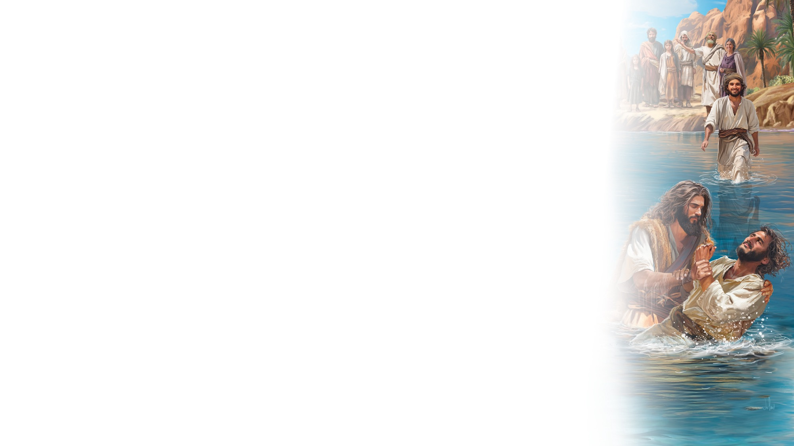
BIG IDEA
God prepares hearts
to receive Jesus.

Slide 19

BIBLE
STORY

Slide 20
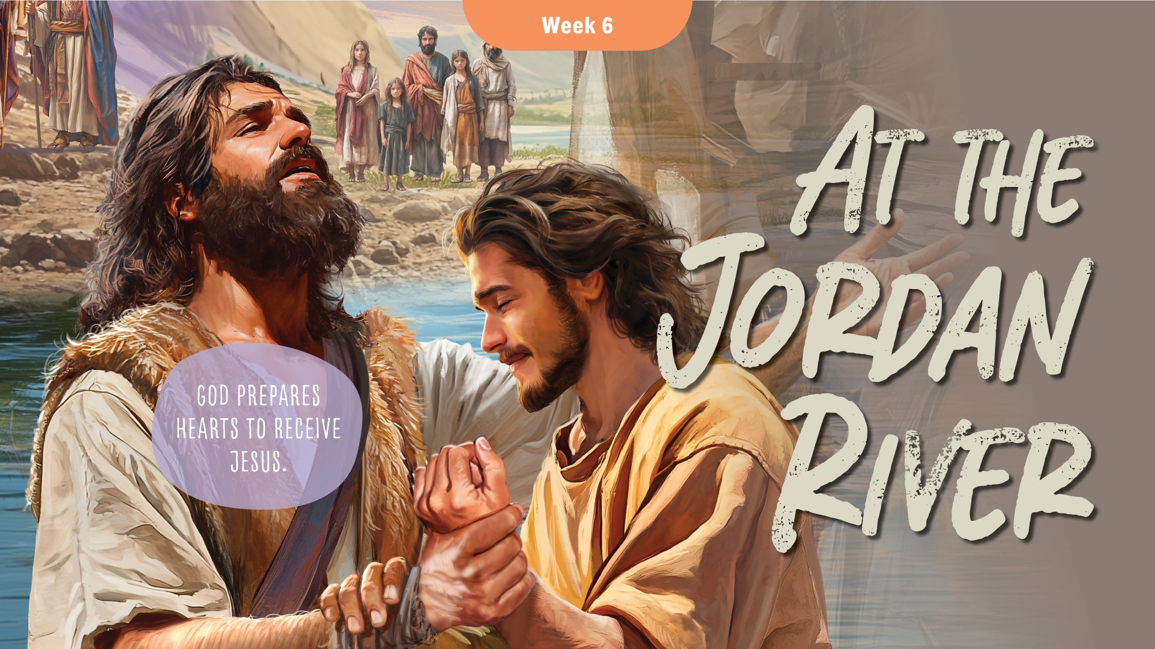

Slide 21
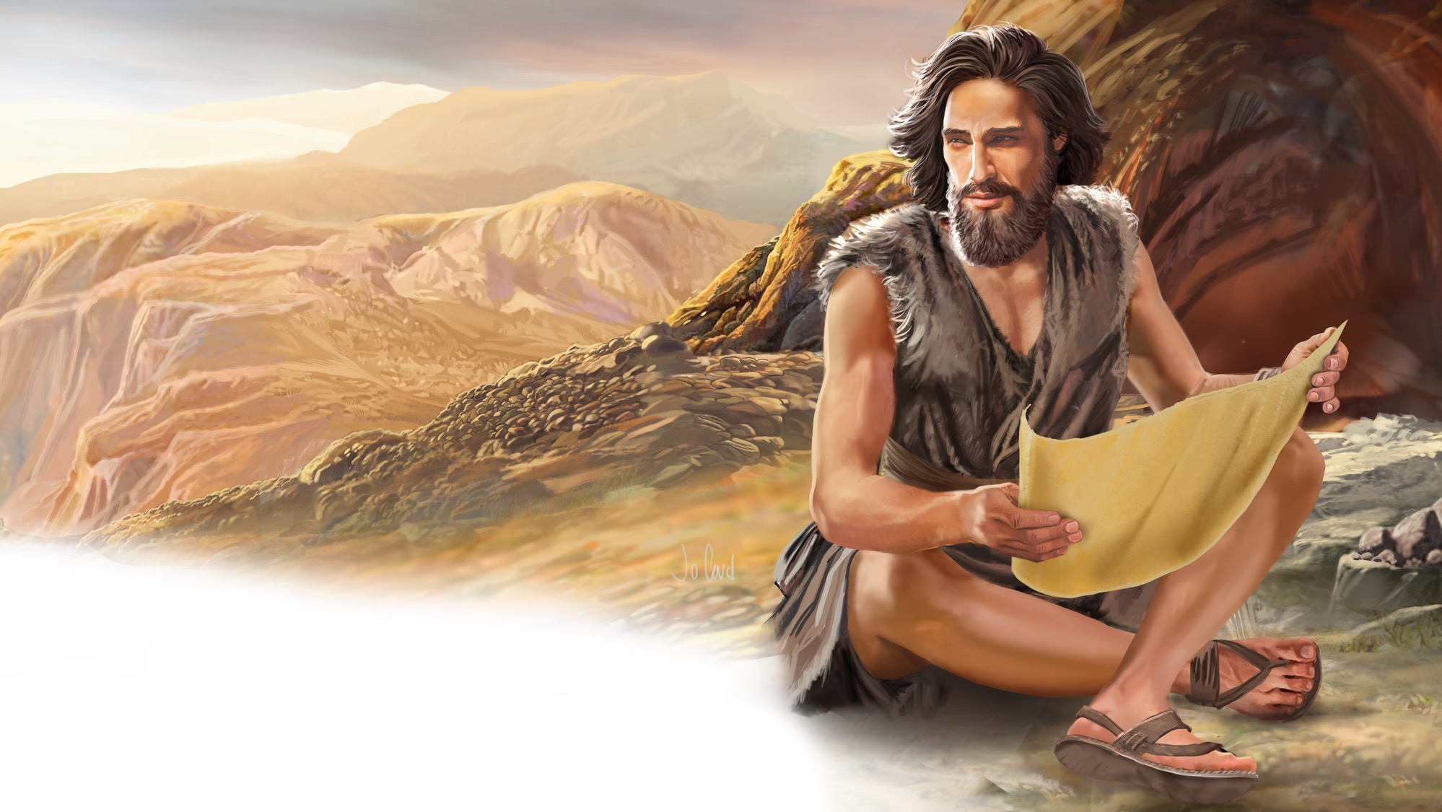
Illustration by Jo Card. Copyright © 2024 General Conference Corporation® of Seventh-day Adventists.

Slide 22
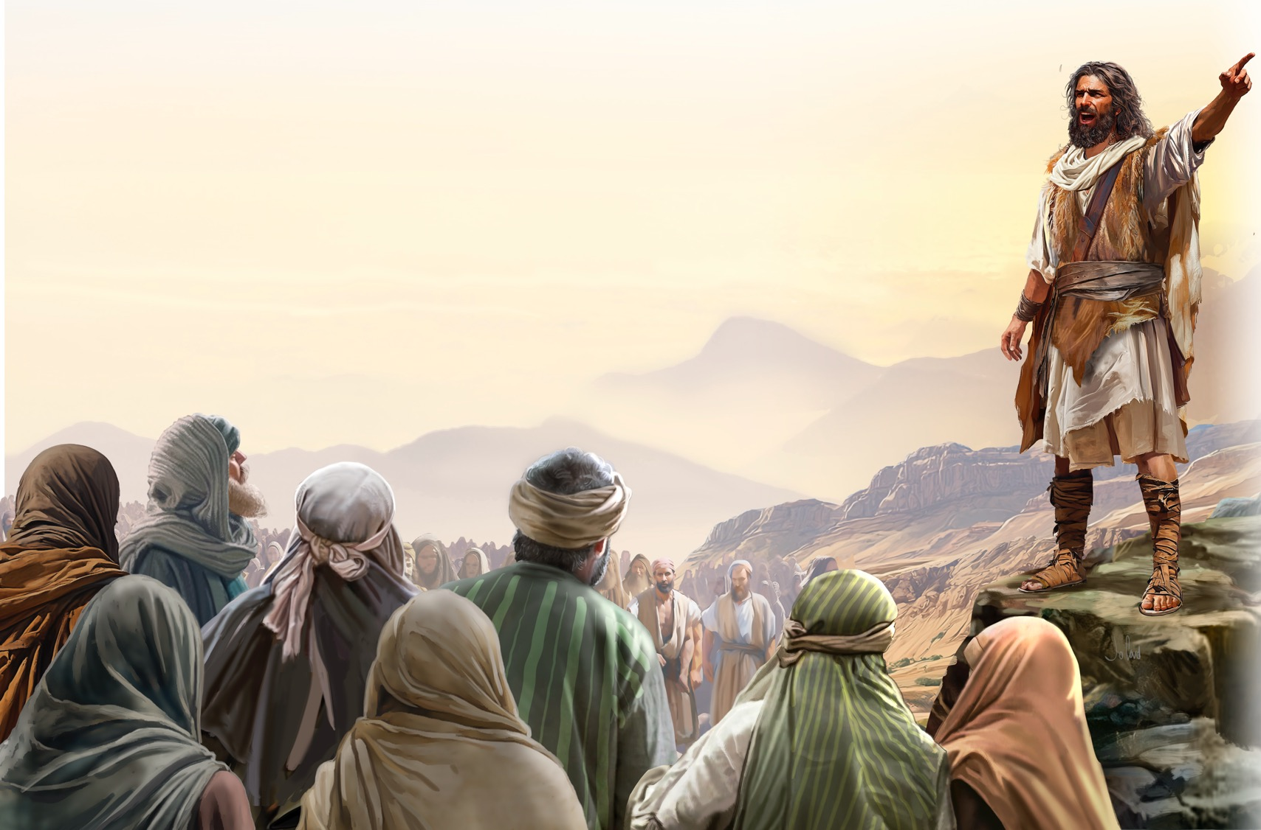
Illustration by Jo Card. Copyright © 2024 General Conference Corporation® of Seventh-day Adventists.

Slide 23
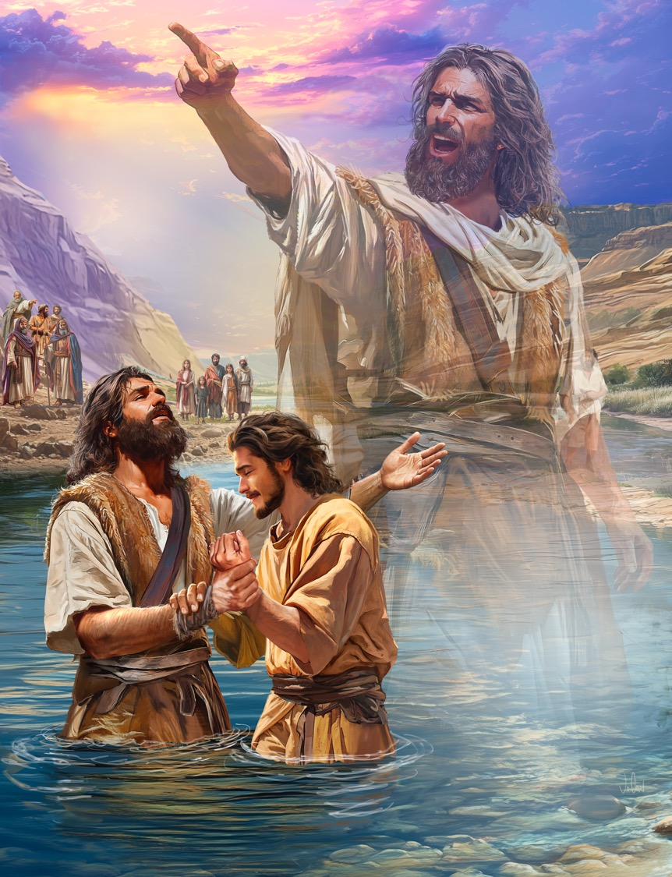
Illustration by Jo Card. Copyright © 2024 General Conference Corporation® of Seventh-day Adventists.

Slide 24
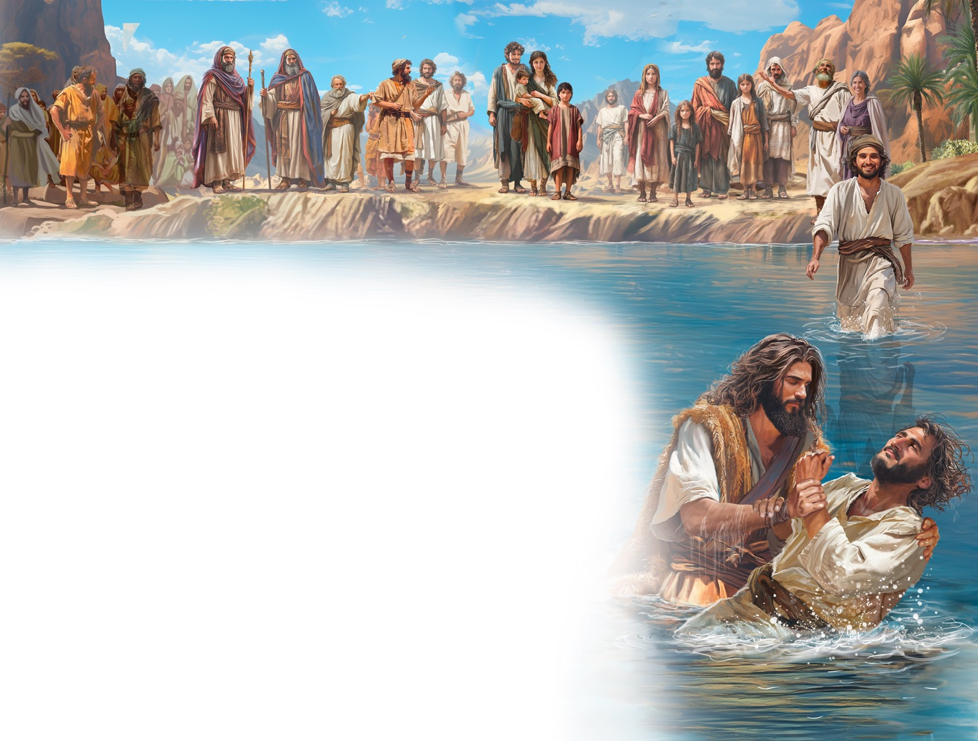
Illustration by Jo Card. Copyright © 2024 General Conference Corporation® of Seventh-day Adventists.

Slide 25
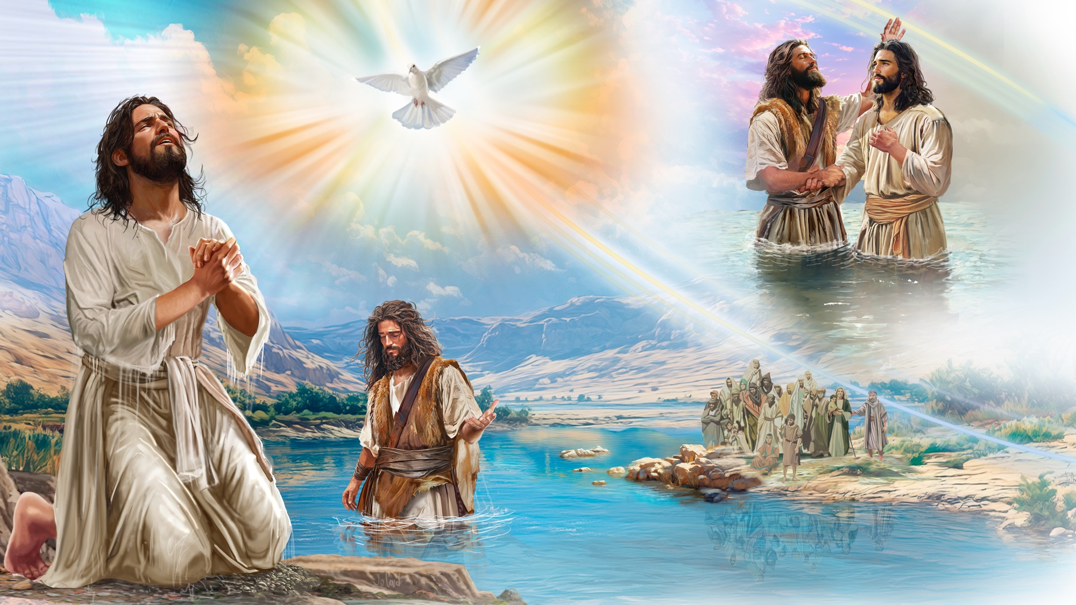
Illustration by Jo Card. Copyright © 2024 General Conference Corporation® of Seventh-day Adventists.

Slide 26
UNPACK
THE STORY

Slide 27

CHARACTER CARDS

Slide 28
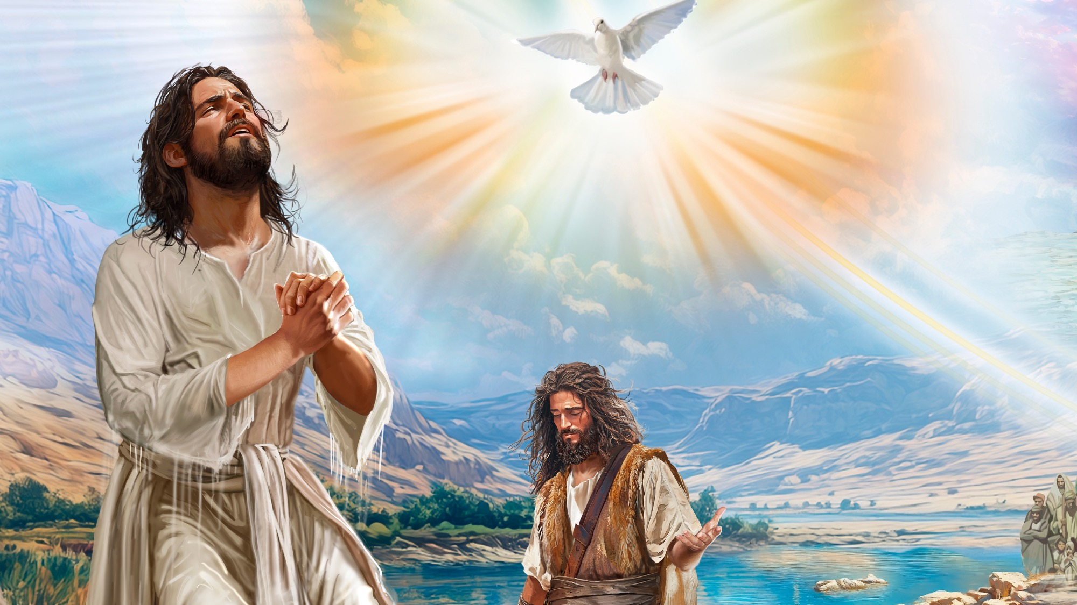
MEMORY VERSE
“I will give you a new heart and put a new spirit within you; I will take the heart of stone out of your flesh and give you a heart of flesh.”
Ezekiel 36:26

Slide 29

Ezekiel 36:26
SCRIPTURE SONG
I will give you a new heart
And put a new Spirit within you.
I will take the heart of stone
Out of your flesh
And give you a heart of flesh.
Ezekiel 36 verse 26.
(Repeat above)
"Ezekiel 36:26" music by Rosie Smith, copyright © 2026 General Conference Corporation® of Seventh-day Adventists.

Slide 30

NATURE
LESSON

Slide 31

CRAFT

Slide 32
I Give My Heart to You
Lord, I give You my heart,
So please take me, shape me.
And fill me with Your love,
Cuz I want to live my life for You.
In everything I do,
Let Your love shine through.
Lord, I give my heart to You.
(Repeat above)
Lord, I give my heart to You. (X2)
"I Give My Heart to You" by Kimberly Houliston, copyright © 2007 Abide Family Ministries. Used by permission.

Slide 33

MISSION
CHALLENGE

Slide 34
BIG IDEA
God prepares hearts
to receive Jesus.

Slide 35

Close to Your Heart
CLOSING SONG
Close to Your heart, close to Your heart,
Jesus, hold me close to Your heart.
Close to Your heart, close to Your heart,
Jesus, hold me close to Your heart.
(Continued on next slide)

Slide 36
Close to Your Heart
CLOSING SONG
When things go wrong
I know where I belong.
Jesus, hold me close to Your heart.
When I stop and pray,
Right through the day,
Jesus, hold me close to Your heart.
(Continued on next slide)

Slide 37
Close to Your Heart
CLOSING SONG
Close to Your heart, close to Your heart,
Jesus, hold me close to Your heart.
Close to Your heart, close to Your heart,
Jesus, hold me close to Your heart.
(Continued on next slide)

Slide 38
Close to Your Heart
CLOSING SONG
When I’m tired and feeling weary,
Jesus, hold me close to Your heart.
I need to know that You are near me
Jesus, hold me close to Your heart.
(Continued on next slide)

Slide 39
Close to Your Heart
CLOSING SONG
Close to Your heart, close to Your heart,
Jesus, hold me close to Your heart.
Close to Your heart, close to Your heart,
Jesus, hold me close to Your heart.
"Close to Your Heart" by Kimberly Houliston, copyright © 2001 Abide Family Ministries. Used by permission.

Slide 40

PRAYER
PRAYER

